Slide 1
Big Mountain Resort
A Data-Driven Review of Pricing Strategies

Slide 2
Problem Identification
There are two issues to address:
Based on resort characteristics, can Big Mountain Resort (“Resort”) increase its lift ticket prices?
Evaluate selected proposals developed by Resort management to allow for increase to life ticket prices?

Slide 3
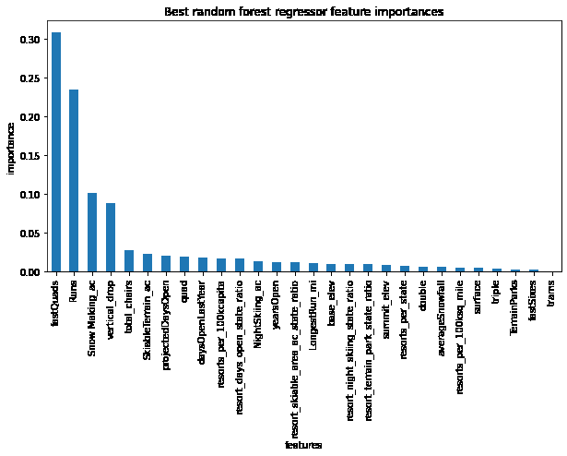
Recommendations and Key Findings
Key drivers of lift prices are:
Number of fast quads
Number of runs
Snow making capacity
Vertical drop
Based on the data, it appears that the Resort may be underpricing its lift tickets compared to the industry
Management proposal to reduce the number of runs may be worth considering, but other proposals appear to either not impact pricing or not impact pricing enough to offset operating expenses

Slide 4
Model Results and Analysis
Based on key industry data, With a current price of 81 USD and a modeled price of 99.83 USD (with a MAE of 10.26 USD), analysis of the data indicates that there is some room for an increase in prices without any changes, through the impact on the projected number of tickets purchased should be examined

Slide 5
Model Results and Analysis
A limited number of run closures may be considered, but as the number of runs closed increased, it appears that pricing power erodes rapidly (please see page 5)
Increasing the vertical drop of the Resort and providing the corresponding lift service provides additional pricing power of an estimated $1mm, but is likely outweighed by increased operating expenses of an estimated $1.5mm
Minor alterations to snowmaking capacity and the length of the longest run appear to provide little pricing power

Slide 6
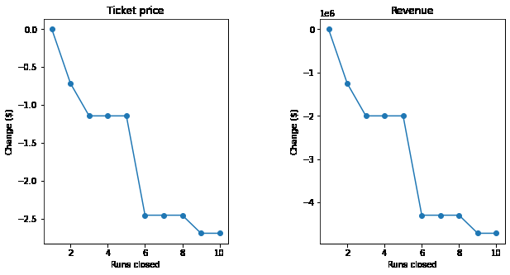
Model Results and Analysis
Model projections show significant decrease in prices after closing two runs

Slide 7
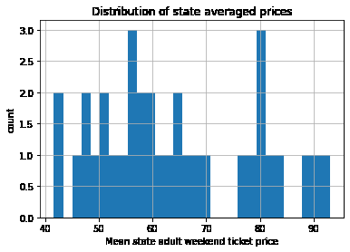
Summary and Conclusion
Resort should explore raising ticket prices, but other strategies may have limited benefits
Changes need to be considered in context of expenses and overall demand especially considering where Resorts lift tickets are currently priced
Additional data, some of which may be relatively easy to obtain could significantly increase utility of the model

